Slide 1
MEMENTO METHOD
PRECIOUS UBI AND YUSRA ADEYERI

Slide 2
MEMENTO METHOD
Memento is a behavioral design pattern that allows you to preserve and restore an object’s former state without exposing the specifics of how it was implemented.
It is often used to implement functions like “rollback” and “undo”

Slide 3
PROBLEM IT SOLVES
Memento design pattern solves the problem of saving and restoring an object's state to a previous version without violating encapsulation.

Slide 4
HOW IT SOLVES THE PROBLEM
The Memento pattern achieves this by using a three-part structure:
Originator: The object whose state you want to save. It creates a snapshot of its state and can restore itself from one.
Memento: A simple, opaque object that holds the saved state. It's like a black box; the caretaker knows it exists, but not what's inside.
Caretaker: An object that manages the mementos. It stores the history of saved states but never directly accesses or modifies the originator's state.

Slide 5
PROS
Encapsulation: It protects the originator's internal state. The memento stores the state without letting other objects access or modify it directly, thus maintaining encapsulation.
Undo/Redo Functionality: It's the classic use case. You can store a history of mementos to allow users to undo or redo actions.
Transaction Management: You can use it to roll back to a previous state if a series of operations fail.
Promotes Cohesion: By keeping the state-saving logic separate from the main object, the originator's code remains focused on its core responsibilities, leading to a cleaner design.

Slide 6
CONS
High Memory Consumption: Storing a complete copy of an object's state for every change can consume a significant amount of memory, especially for large or complex objects.
Performance Overhead: Creating a snapshot of a complex state can be computationally expensive, potentially impacting application performance.
Scalability Issues: It may not be well-suited for applications that need to manage the state of numerous objects or objects with very large states due to the memory and performance costs.

Slide 7
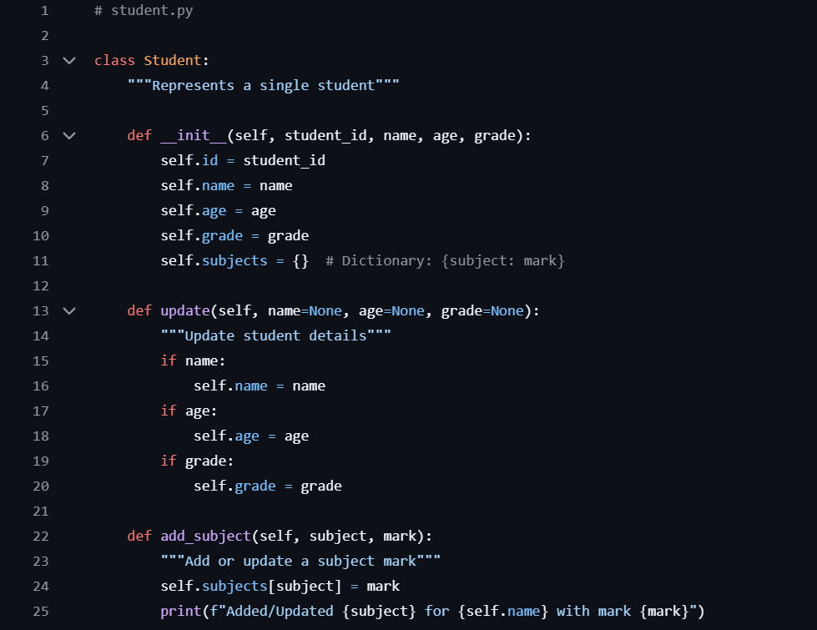
CODE SNIPPET PROBLEM:

Slide 8
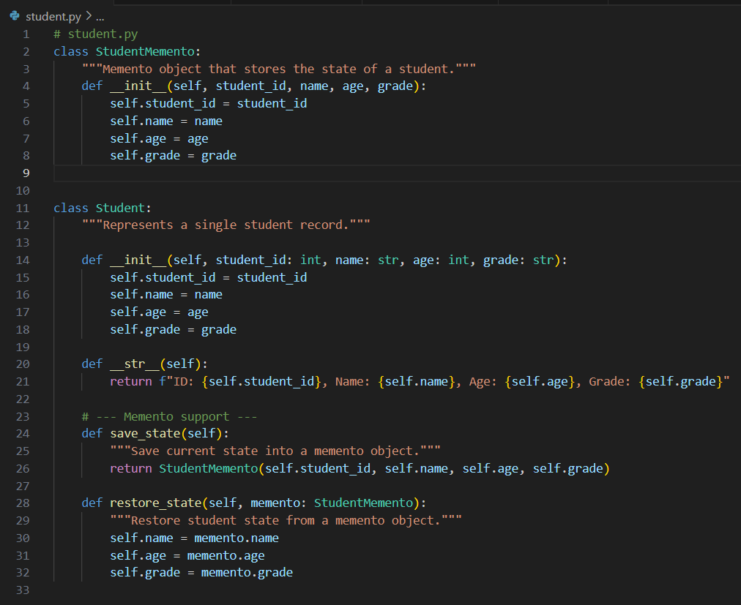
CODE SNIPPET SOLUTION:

Slide 9
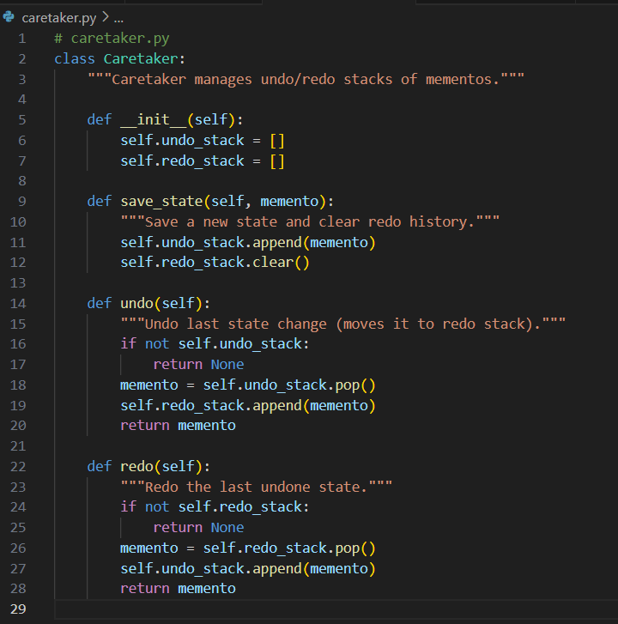
CARETAKER.PY FILE:
In the memento design pattern, the caretaker is responsible for managing saved states (Mementos) of an object, without modifyiing them directly.
It doesn't know what is inside the Memento (encapsulation is preserved), it only stores them in undo/redo stacks and applies them when asked and lastly, it makes the system behave like an editor (undo/redo functionality)
The caretaker class has the __init__ constructor that initializes the undo_stack function and redo_stack function. The self.undo_stack = [] is a list that holds past ststes (so we can go backwards = undo) while the self.redo_stack = [] is a list that holds undone states (so we can go forwards = redo).
When we call save(student) before modifying a student, student.save() creates a memento object containing the student's current state (ID, name, age, grade) that is stored in the undo.stack.
The redo_stack is cleared because whenever you perform a new action, the "redo history" becomes invalid (just like MS Word or Photoshop).
If undo_stack is empty, there will be nothing to undo. Otherwise:
- memento = self.undo_stack.pop() -> take the most recent saved state.
- self.redo_stack.append(memento) -> pushes it to redo_stack so we can redo later.
- memento.restore() -> reverts the Student object back to the state stored in the memento.
if redo_stack is empty, there will be nothing to redo. Otherwise:
- memento = self.redo_stack.pop() -> gets the most recent undone state.
- self.undo_stack.append(memento) -> moves it back to undo history.
- memento.restore() -> reapplies the undone change.

Slide 10
THANK YOU

